Slide 1
Virtual Interactive Board
Prepared by:-
Vaibhav Mittal
Vaibhav Singh
Sarthak Srivastava

Slide 2
Introduction
Sketching On Air is possible through our trending technology namely OpenCV, python.
OpenCV is mainly known as an open source computer vision and machine learning software.
Most of the algorithms are used to detect and recognize faces, identify objects, classify human activities in videos track camera movements, track moving object.
In this project we are solving a real life problem by replacing the physical interactive boards with a virtual one.

Slide 3

What is Virtual Interactive Board?
Computer vision project implemented with OpenCV.
In air canvas you can draw on the screen with only waiving your finger around in the air. Its a color tracking project with a small color bead on the finger.
Color Detection and tracking are used in order to achieve the objective.
A mask is created around the bead and then the color marker is predicted. It includes further steps of morphological operations on the mask produced which are Erosion and Dilation. Erosion reduces the impurities present in the mask and dilation further restores the eroded main mask.

Slide 4
What problem it solves?
With the sudden shut down of schools and colleges in many parts of the globe because of the pandemic, education has shifted online.
Teachers are teaching students over online meeting platforms. But to write on the whiteboards available online, a special pen is needed which is often expensive.
This problem is solved by Virtual Interactive Board. Now teachers can write on the virtual whiteboard just by waving their fingers in the air, free of cost.
Availability of Physical Interactive Boards isn’t easy.
It reduces the cost of investment for physical interactive boards.
Isn't it amazing?

Slide 5
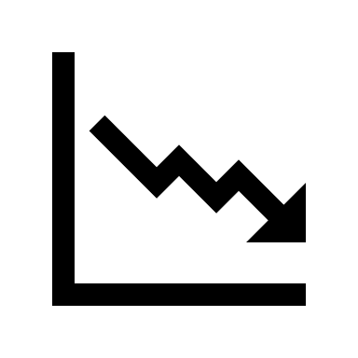

Features
Replaces expensive physical interactive boards.
No need to use additional hardware during presentation.
Convenient to use.
Cost effective.

Slide 6
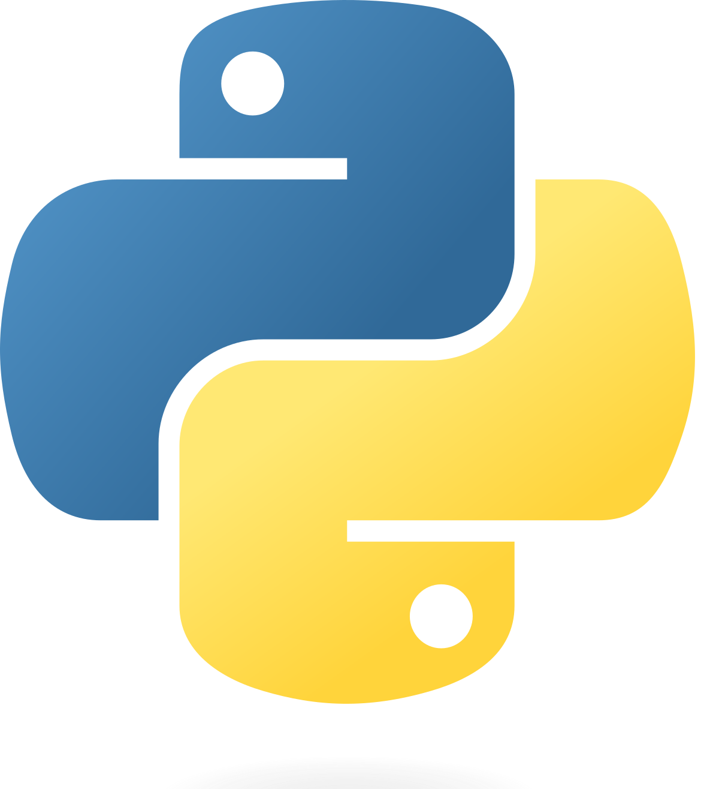
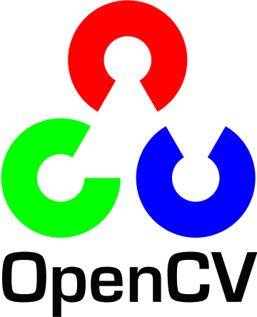
Prerequisites of the project
Python programming language
MediaPipe
OpenCv
NumPy

Slide 7
OpenCV-Python is a library of Python bindings designed to solve computer vision problems. OpenCV (Open Source Computer Vision Library) is an open source computer vision and machine learning software library.
NumPy is a Python library used for working with arrays. It also has functions for working in domain of linear algebra, fourier transform, and matrices.
MediaPipe is a cross-platform pipeline framework to build custom machine learning solutions for live and streaming media. The framework was open sourced by Google and is currently in the alpha stage.

Slide 8

Libraries used:
OpenCV
NumPy
MediaPipe

Slide 9
Working of the project
Start reading the frames and convert the captured frames to HSV color space. (Easy for color detection)
Prepare the canvas frame and put the respective ink buttons on it.
Adjust the trackbar values for finding the mask of colored marker.
Preprocess the mask with morphological operations.(Erosion and Dilation)
Detect the contours, find the center coordinates of largest contour and keep storing them in the array for successive frames .(Arrays for drawing points on canvas)
Finally draw the points stored in array on the frames and canvas .

Slide 10
Flow Chart
WEBCAM
OPENCV
FLIP VIDEO
DETECSHAND LANDMARK MODEL
DETECTS FINGERTIP
EXIT
DISPLAY ON OUTPUT WINDOW
DRAW/WRITE/ERASE
SELECT TOOL

Slide 11
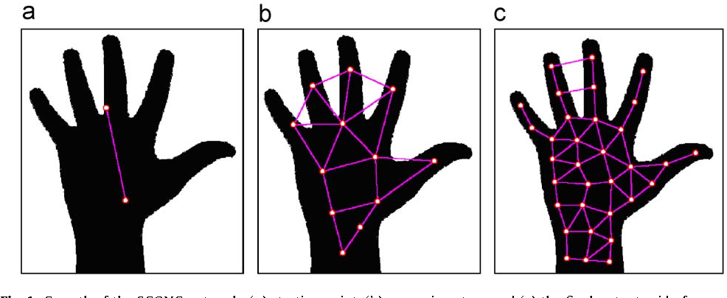
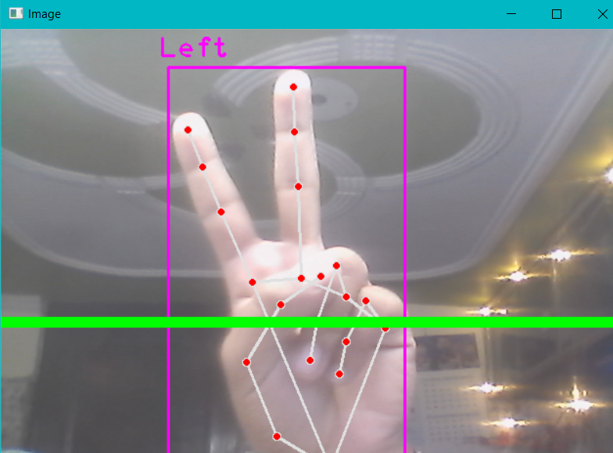
HAND RECOGNITION

Slide 12
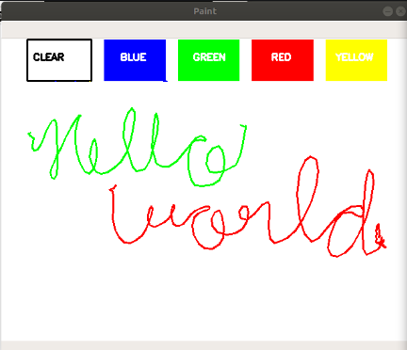
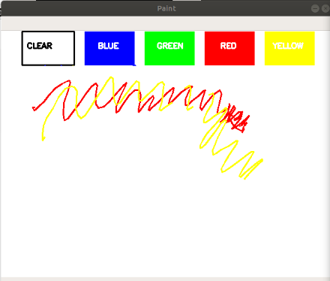
Virtual Interactive Board

Slide 13
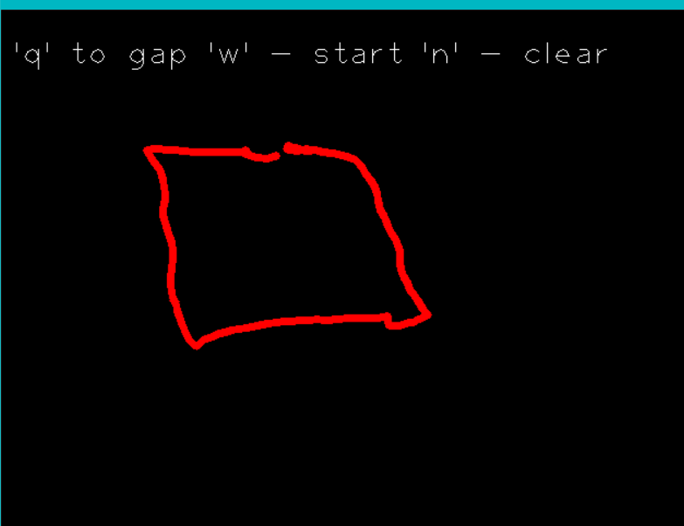
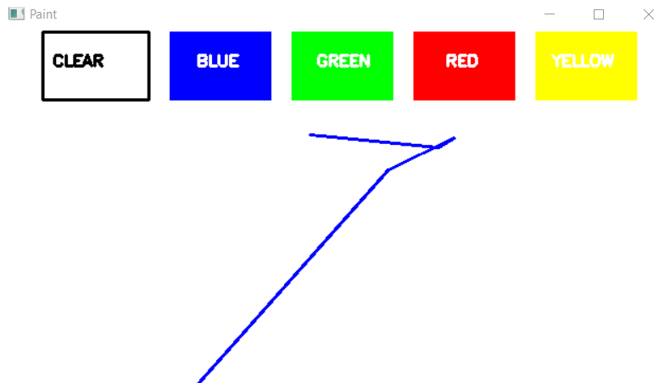
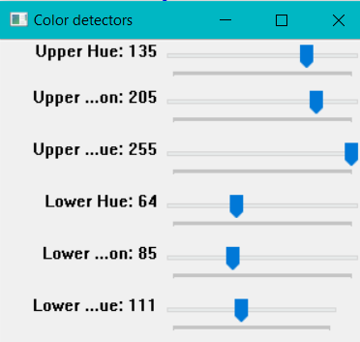

Slide 14
Conclusion
This project makes the user to have an interactive environment where the user can draw whatever he wants by choosing his required colors from the displayed ones. So, we conclude that Virtual Sketch is developed using the library NumPy and in Open CV where we have many libraries and algorithm in built which makes the interfaces more active while using.
We used python as, it have many inbuilt libraries and many modules which represent the imagination virtually when used along with OpenCV as well as its morphological processes.

Slide 15
Thank You

